Slide 1
Chapter 1 Computer System Overview
Operating Systems: Internals and Design Principles
Ninth Edition
By William Stallings
Notes:
“Operating Systems: Internal and Design Principles”, 9/e, by William Stallings, Chapter 1 “Computer System Overview”.

Slide 2
Objectives
Cache memory
Concepts, terminology
Mapping
Direct Memory Access
Notes:
Table 1.1 lists the most common classes of interrupts.

Slide 3
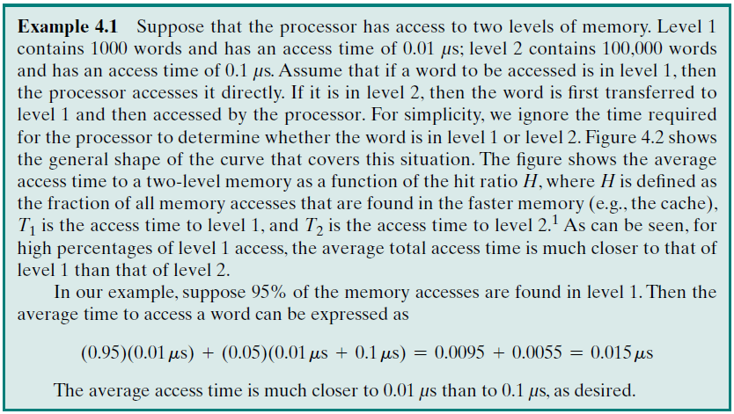
Example: Effects of Memory Hierarchy

Slide 4
Notes:
Suppose that the processor has access to two levels of memory. Level 1 contains 1,000 bytes and has an access time of 0.1 μs; level 2 contains 100,000 bytes and has an access time of 1 μs. Assume that if a byte to be accessed is in level 1, then the processor accesses it directly. If it is in level 2, then the byte is first transferred to level 1 and then accessed by the processor. For simplicity, we ignore the time required for the processor to determine whether the byte is in level 1 or level 2.
Figure 1.15 shows the general shape of the curve that models this situation. The figure shows the average access time to a two-level memory as a function of the hit ratio H , where H is defined as the fraction of all memory accesses that are found in the faster memory (e.g., the cache), T₁ is the access time to level 1, and T₂ is the access time to level 2. As can be seen, for high percentages of level 1 access, the average total access time is much closer to that of level 1 than that of level 2.
In our example, suppose 95% of the memory accesses are found in the cache (H = 0.95) . Then the average time to access a byte can be expressed as
(0.95) (0.1 s) + (0.05) (0.1 s + 1 s) = 0.095 + 0.055 = 0.15 us
The result is close to the access time of the faster memory. So the strategy of using two memory levels works in principle, but only if conditions (a) through (d) in the preceding list apply. By employing a variety of technologies, a spectrum of memory systems exists that satisfies conditions (a) through (c). Fortunately, condition (d) is also generally valid.

Slide 5
Principle of Locality
Memory references by the processor tend to cluster
Data is organized so that the percentage of accesses to each successively lower level is substantially less than that of the level above
Can be applied across more than two levels of memory
Notes:
The basis for the validity of condition (d) is a principle known as locality of reference [DENN68]. During the course of execution of a program, memory references by the processor, for both instructions and data, tend to cluster. Programs typically contain a number of iterative loops and subroutines. Once a loop or subroutine is entered, there are repeated references to a small set of instructions. Similarly, operations on tables and arrays involve access to a clustered set of data bytes. Over a long period of time, the clusters in use change, but over a short period of time, the processor is primarily working with fixed clusters of memory references.
Accordingly, it is possible to organize data across the hierarchy such that the percentage of accesses to each successively lower level is substantially less than that of the level above. Consider the two-level example already presented. Let level 2 memory contain all program instructions and data. The current clusters can be temporarily placed in level 1. From time to time, one of the clusters in level 1 will have to be swapped back to level 2 to make room for a new cluster coming in to level 1. On average, however, most references will be to instructions and data contained in level 1.
This principle can be applied across more than two levels of memory. The fastest, smallest, and most expensive type of memory consists of the registers internal to the processor. Typically, a processor will contain a few dozen such registers, although some processors contain hundreds of registers. Skipping down two levels, main memory is the principal internal memory system of the computer. Each location in main memory has a unique address, and most machine instructions refer to one or more main memory addresses. Main memory is usually extended with a higher-speed, smaller cache. The cache is not usually visible to the programmer or, indeed, to the processor. It is a device for staging the movement of data between main memory and processor registers to improve performance.

Slide 6
Locality
Locality
Temporal: Recently Executed Instructions are likely to be executed again
Spatial: Those instructions close to Recently Executed Instructions (address point of view) are likely to be executed soon.
You are strongly advised to read the definitions and additional explanations of page 35.

Slide 7
Secondary Memory
Also referred to as auxiliary memory
External
Nonvolatile
Used to store program and data files
Notes:
The three forms of memory just described are, typically, volatile and employ semiconductor technology. The use of three levels exploits the fact that semiconductor memory comes in a variety of types, which differ in speed and cost. Data are stored more permanently on external mass storage devices, of which the most common are hard disk and removable media, such as removable disk, tape, and optical storage. External, nonvolatile memory is also referred to as secondary memory or auxiliary memory . These are used to store program and data files, and are usually visible to the programmer only in terms of files and records, as opposed to individual bytes or words. A hard disk is also used to provide an extension to main memory known as virtual memory, which is discussed in Chapter 8 .

Slide 8
Cache Memory
Invisible to the OS
Interacts with other memory management hardware
Processor must access memory at least once per instruction cycle
Processor execution is limited by memory cycle time
Exploit the principle of locality with a small, fast memory
Notes:
Although cache memory is invisible to the OS, it interacts with other memory management hardware. Furthermore, many of the principles used in virtual memory schemes (discussed in Chapter 8 ) are also applied in cache memory.
On all instruction cycles, the processor accesses memory at least once, to fetch the instruction, and often one or more additional times, to fetch operands and/ or store results. The rate at which the processor can execute instructions is clearly limited by the memory cycle time (the time it takes to read one word from or write one word to memory). This limitation has been a significant problem because of the persistent mismatch between processor and main memory speeds: Over the years, processor speed has consistently increased more rapidly than memory access speed. We are faced with a trade-off among speed, cost, and size. Ideally, main memory should be built with the same technology as that of the processor registers, giving memory cycle times comparable to processor cycle times. This has always been too expensive a strategy. The solution is to exploit the principle of locality by providing a small, fast memory between the processor and main memory, namely the cache.

Slide 9
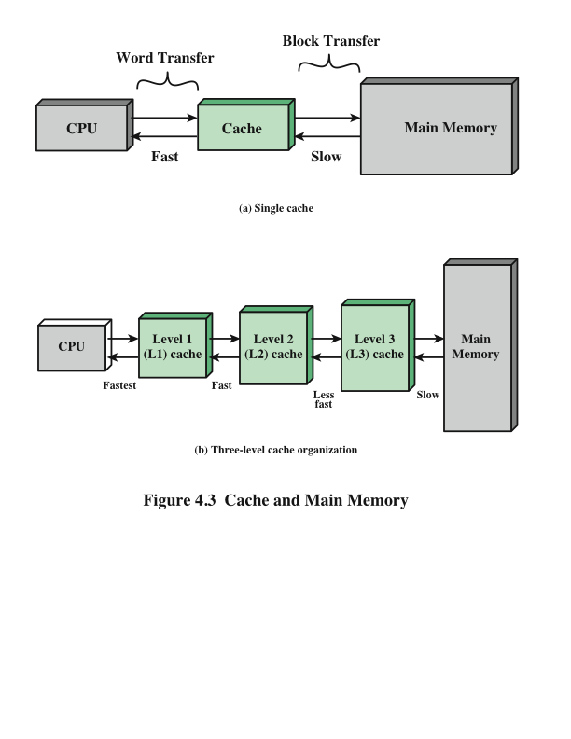
Cache and Main Memory

Slide 10
Notes:
Figure 1.17 depicts the structure of a cache/main memory system. Main memory consists of up to 2 ^{n} addressable words, with each word having a unique n –bit address. For mapping purposes, this memory is considered to consist of a number of fixed-length blocks of K words each. That is, there are M = 2^{n}/K blocks. Cache consists of C slots (also referred to as lines ) of K words each, and the number of slots is considerably less than the number of main memory blocks (C<<M) . Some subset of the blocks of main memory resides in the slots of the cache. If a word in a block of memory that is not in the cache is read, that block is transferred to one of the slots of the cache. Because there are more blocks than slots, an individual slot cannot be uniquely and permanently dedicated to a particular block. Therefore, each slot includes a tag that identifies which particular block is currently being stored. The tag is usually some number of higher-order bits of the address and refers to all addresses that begin with that sequence of bits.

Slide 11
Notes:
Figure 1.18 illustrates the read operation. The processor generates the address, RA, of a word to be read. If the word is contained in the cache, it is delivered to the processor. Otherwise, the block containing that word is loaded into the cache and the word is delivered to the processor.

Slide 12
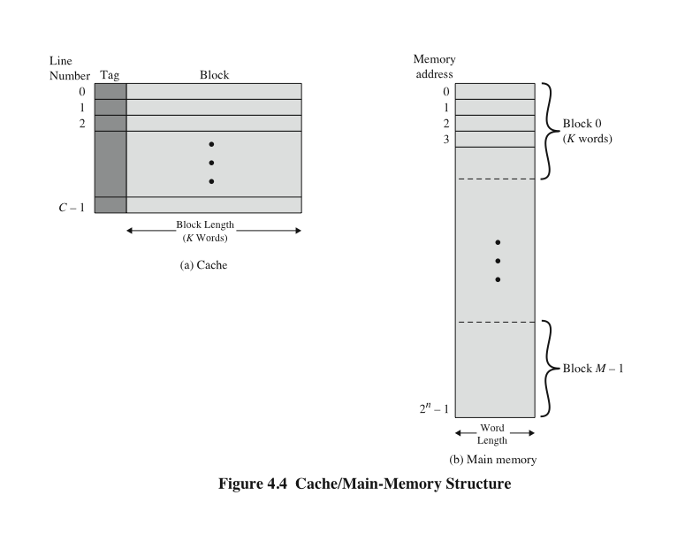
Cache/Main Memory Structure
Cache memory
Line size: K-words, same as a MM-Block.
Number of Blocks: (m). Depend on physical capacity
Tag: WHAT ? WHY?
Main memory (MM)
Each address has: n-bits
Number of words: 2^n
Each Block is a package of:
K-words
Total # of Blocks (M):
(2^n)/K = M
There are more MM-Blocks than Cache memory lines, as a consequence an individual line CANNOT be uniquely and permanently dedicated to a particular block
Tag: identifies which particular MM-Block is currently being stored in cache.
Tag: Is usually a portion of the MM-address
Notes:
Figure 4.4 depicts the structure of a cache/main-memory system.

Slide 13
Cache and Main Memory
Example #2
You need to analyze the info below (in black), and answer the questions in red.
Cache:
128 lines = 128 Blocks
16 Words per line (One Block)
Cache capacity [words]= ?
Main Memory
16 bit address
Capacity [words] = ?
# of Blocks = ?
Notes:
Cache memory is designed to combine the memory access time of expensive, high-speed
memory combined with the large memory size of less expensive, lower-speed
memory.
The concept is illustrated in Figure 4.3a. There is a relatively large and slow
main memory together with a smaller, faster cache memory. The cache contains a
copy of portions of main memory. When the processor attempts to read a word of
memory, a check is made to determine if the word is in the cache. If so, the word is
delivered to the processor. If not, a block of main memory, consisting of some fixed
number of words, is read into the cache and then the word is delivered to the processor.
Because of the phenomenon of locality of reference, when a block of data is
fetched into the cache to satisfy a single memory reference, it is likely that there will
be future references to that same memory location or to other words in the block.
Figure 4.3b depicts the use of multiple levels of cache. The L2 cache is slower
and typically larger than the L1 cache, and the L3 cache is slower and typically
larger than the L2 cache.

Slide 14
Cache and Main Memory
Example #2
Let’s Analyze Cache Memory:
128 lines = 128 Blocks
16 Words per line (Block)
Cache capacity = (128 lines)*(16 words per line) = 2048 words
Notes:
Cache memory is designed to combine the memory access time of expensive, high-speed
memory combined with the large memory size of less expensive, lower-speed
memory.
The concept is illustrated in Figure 4.3a. There is a relatively large and slow
main memory together with a smaller, faster cache memory. The cache contains a
copy of portions of main memory. When the processor attempts to read a word of
memory, a check is made to determine if the word is in the cache. If so, the word is
delivered to the processor. If not, a block of main memory, consisting of some fixed
number of words, is read into the cache and then the word is delivered to the processor.
Because of the phenomenon of locality of reference, when a block of data is
fetched into the cache to satisfy a single memory reference, it is likely that there will
be future references to that same memory location or to other words in the block.
Figure 4.3b depicts the use of multiple levels of cache. The L2 cache is slower
and typically larger than the L1 cache, and the L3 cache is slower and typically
larger than the L2 cache.

Slide 15
Cache and Main Memory
Example #2
Let’s analyze Main Memory
16 bit address
Capacity = 2^16 = 65536 words = 64K
How many times will cache fit in MM =
=(MM Capacity [words]) / (# cache mem capacity [words])
= (65536)/(2048) = 32 times
MM capacity in Blocks = 128*32 = 4096 = 4k blocks
Notes:
Cache memory is designed to combine the memory access time of expensive, high-speed
memory combined with the large memory size of less expensive, lower-speed
memory.
The concept is illustrated in Figure 4.3a. There is a relatively large and slow
main memory together with a smaller, faster cache memory. The cache contains a
copy of portions of main memory. When the processor attempts to read a word of
memory, a check is made to determine if the word is in the cache. If so, the word is
delivered to the processor. If not, a block of main memory, consisting of some fixed
number of words, is read into the cache and then the word is delivered to the processor.
Because of the phenomenon of locality of reference, when a block of data is
fetched into the cache to satisfy a single memory reference, it is likely that there will
be future references to that same memory location or to other words in the block.
Figure 4.3b depicts the use of multiple levels of cache. The L2 cache is slower
and typically larger than the L1 cache, and the L3 cache is slower and typically
larger than the L2 cache.

Slide 16
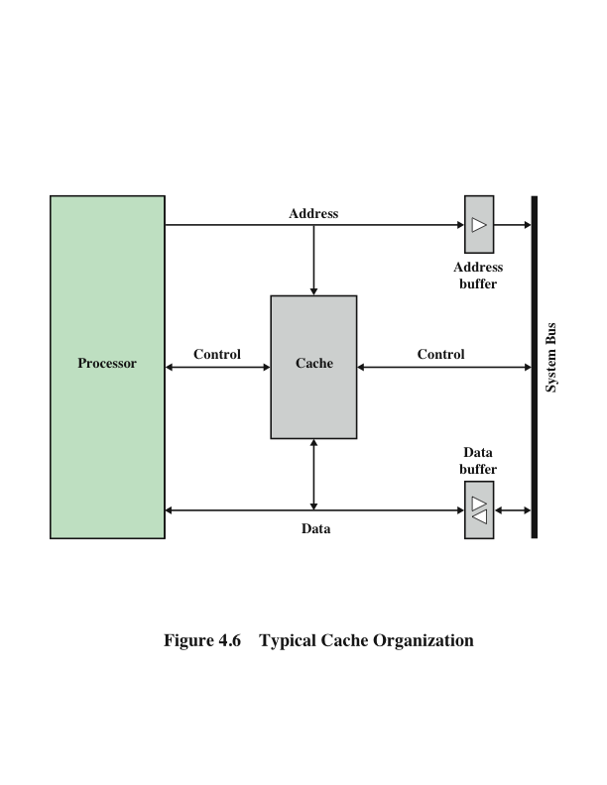
Typical Cache Organization
Notes:
Figure 4.5 shows these last two
operations occurring in parallel and reflects the organization shown in Figure 4.6,
which is typical of contemporary cache organizations. In this organization, the cache
connects to the processor via data, control, and address lines. The data and address
lines also attach to data and address buffers, which attach to a system bus from
which main memory is reached. When a cache hit occurs, the data and address buffers
are disabled and communication is only between processor and cache, with no
system bus traffic. When a cache miss occurs, the desired address is loaded onto the
system bus and the data are returned through the data buffer to both the cache and
the processor. In other organizations, the cache is physically interposed between
the processor and the main memory for all data, address, and control lines. In this
latter case, for a cache miss, the desired word is first read into the cache and then
transferred from cache to processor.

Slide 17
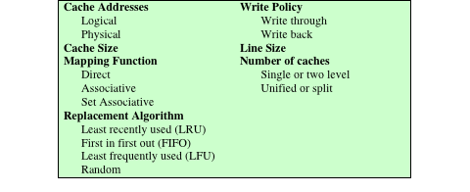
Elements of Cache Design
Table 4.2 Elements of Cache Design
Notes:
This section provides an overview of cache design parameters and reports some
typical results. We occasionally refer to the use of caches in high-performance computing
(HPC). HPC deals with supercomputers and their software, especially for
scientific applications that involve large amounts of data, vector and matrix computation,
and the use of parallel algorithms. Cache design for HPC is quite different
than for other hardware platforms and applications. Indeed, many researchers
have found that HPC applications perform poorly on computer architectures that
employ caches [BAIL93]. Other researchers have since shown that a cache hierarchy
can be useful in improving performance if the application software is tuned to
exploit the cache [WANG99, PRES01].
Although there are a large number of cache implementations, there are a few
basic design elements that serve to classify and differentiate cache architectures.
Table 4.2 lists key elements.

Slide 18
Cache Design
Main categories are:
Cache size
Block size
Mapping function
Write policy
Number of cache levels
Replacement algorithm
Notes:
A detailed discussion of cache design is beyond the scope of this book. Key elements are briefly summarized here. We will see that similar design issues must be addressed in dealing with virtual memory and disk cache design. They fall into the following categories:
• Cache size
• Block size
• Mapping function
• Replacement algorithm
• Write policy
• Number of cache levels

Slide 19
Cache and Block Size
Cache Size
Small caches have significant impact on performance
Block Size
The unit of data exchanged between cache and main memory
Notes:
We have already dealt with the issue of cache size . It turns out that reasonably small caches can have a significant impact on performance. Another size issue is that of block size : the unit of data exchanged between cache and main memory. As the block size increases from very small to larger sizes, the hit ratio will at first increase because of the principle of locality: the high probability that data in the vicinity of a referenced word are likely to be referenced in the near future. As the block size increases, more useful data are brought into the cache. The hit ratio will begin to decrease, however, as the block becomes even bigger and the probability of using the newly fetched data becomes less than the probability of reusing the data that have to be moved out of the cache to make room for the new block.

Slide 20
Mapping Function
Determines which cache location the block will occupy
Two constraints affect design:
When one block is read in, another may have to be replaced
The more flexible the mapping function, the more complex is the circuitry required to search the cache
Notes:
When a new block of data is read into the cache, the mapping function determines which cache location the block will occupy. Two constraints affect the design of the mapping function. First, when one block is read in, another may have to be replaced. We would like to do this in such a way as to minimize the probability that we will replace a block that will be needed in the near future. The more flexible the mapping function, the more scope we have to design a replacement algorithm to maximize the hit ratio. Second, the more flexible the mapping function, the more complex is the circuitry required to search the cache to determine if a given block is in the cache.

Slide 21
Replacement Algorithm
Least Recently Used (LRU) Algorithm
Effective strategy is to replace a block that has been in the cache the longest with no references to it
Hardware mechanisms are needed to identify the least recently used block
Chooses which block to replace when a new block is to be loaded into the cache
Notes:
The replacement algorithm chooses, within the constraints of the mapping function, which block to replace when a new block is to be loaded into the cache and the cache already has all slots filled with other blocks. We would like to replace the block that is least likely to be needed again in the near future. Although it is impossible to identify such a block, a reasonably effective strategy is to replace the block that has been in the cache longest with no reference to it. This policy is referred to as the least-recently-used (LRU) algorithm. Hardware mechanisms are needed to identify the least-recently-used block.

Slide 22
Write Policy
Dictates when the memory write operation takes place
Option 1: Can occur every time the block is updated
Option 2: Can occur when the block is replaced
Minimizes write operations
Leaves main memory in an obsolete state
Notes:
If the contents of a block in the cache are altered, then it is necessary to write it back to main memory before replacing it. The write policy dictates when the memory write operation takes place. At one extreme, the writing can occur every time that the block is updated. At the other extreme, the writing occurs only when the block is replaced. The latter policy minimizes memory write operations but leaves main memory in an obsolete state. This can interfere with multiple-processor operation and with direct memory access by I/O hardware modules.
Finally, it is now commonplace to have multiple levels of cache, labeled L1
(cache closest to the processor), L2, and in many cases a third level L3. A discussion
of the performance benefits of multiple cache levels is beyond our scope; see
[STAL16] for a discussion.

Slide 23
Objectives
Understand Direct Mapping
Understand Associative Mapping
Understand Set Associative Mapping
Reinforce the concepts of
Tag
Word
Block
Set
Main Memory
Cache
Hit
Miss
Notes:
22
To understand the organization of the processor, let us consider the requirements placed on the processor, the things that it must do:
Fetch instruction: The processor reads an instruction from memory (register, cache, main memory).
Interpret instruction: The instruction is decoded to determine what action is required.
Fetch data: The execution of an instruction may require reading data from memory or an I/O module.
Process data: The execution of an instruction may require performing some arithmetic or logical operation on data.
Write data: The results of an execution may require writing data to memory or an I/O module.
To do these things, it should be clear that the processor needs to store some data temporarily. It must remember the location of the last instruction so that it can know where to get the next instruction. It needs to store instructions and data temporarily while an instruction is being executed. In other words, the processor needs a small internal memory.

Slide 24
For the next tree (3) following Mappings, this are the specs for PC # 1
Cache
128 blocks ; 16 words per block ; Total: 2048 (2K) words
Main Memory
16-bit addressable (means = 2^16 = 65536 (64K) addressable units. Better said 64K words.
(64k words)*{1 Block/16 [words]} = 4k Blocks (each block with 16-words)
Keep this in mind for later:
MM can be divided into 32 cache-size groups.

Slide 25
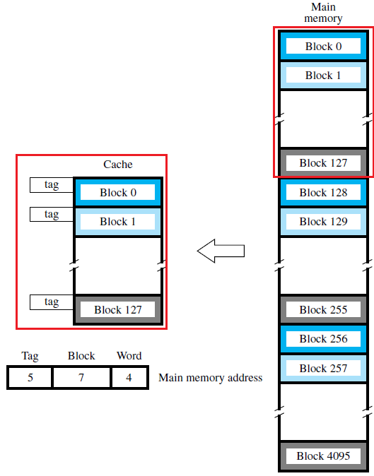
Direct
Mapping
Each Block Has 16 word. In order for me to ID 1 out of 16 words I need 4 bits, because 2^4 = 16 (Word)
In cache memory we have a total of 128 blocks. In order for us to ID 1 out of 128 possible blocks I need 7 bits, because 2^7 = 128 (Block)
We can divide Main Memory in cache-size groups a total 0f 32 times. In order for me to ID 1 our of 32 possible cache-size groups I need 5 bits, because 2^5 = 32 (Tag)
5+7+4 = 16 bits
Analogy: When you are invited to our hotel (Cache) you will always be required to go to the same room (Block). If the room (Block) is occupied, whomever happens to be there MUST leave.

Slide 26
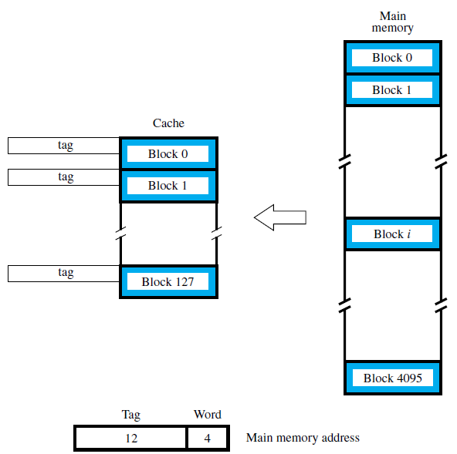
Associative
Mapping
Each Block Has 16 word. In order for me to ID 1 our of 16 words I need 4 bits, because 2^4 = 16 (Word)
MM has 4K blocks. Any of those blocks can go to ANY block in cache memory. In order for us to ID 1 out of 4096 MM blocks we need 12 bits, because 2^12 = 4096
There is NO need of a “Block field” because a block from MM can go into any Cache Block location, and we can keep track of it with the “Tag Field”
12+4 = 16 bits
Analogy: when you are invited to our hotel (Cache), you can go to any room (Block) in the building (Cache)

Slide 27
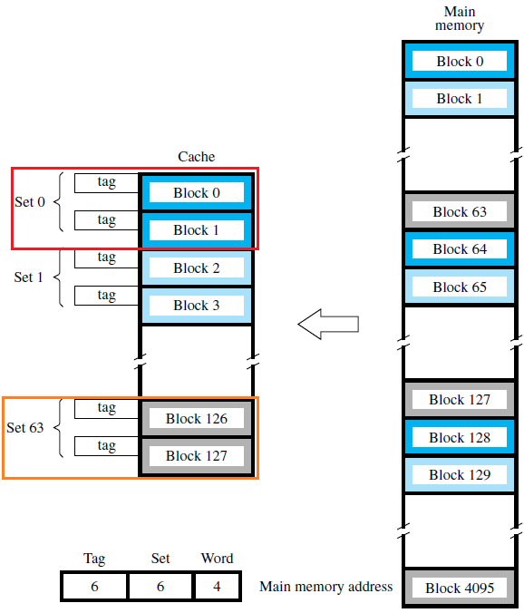
SET
Associative Mapping
Combines
Direct Mapping
Associative Mapping
Divides cache into Cache-SETS
A SET is a group of Blocks
Each Block Has 16 word. In order for me to ID 1 out of 16 words I need 4 bits, because 2^4 = 16 (Word)
How many SETS do you have?. In this case we have 64. how many bits do I need to ID 1 out of 64 possible sets? Answer: 6 bits, because 2^6 = 64 (Set)
The tag field of the address must then be associatively compared to the tags of the two blocks of the set to check if the desired block is present
6+6+4 = 16 bits
Size of set: 2 (blocks), so it is called 2-Way associative
Analogy: When you are invited to our hotel (Cache), you will be required to go to a specific floor (SET {Direct Mapping}); once you are in that floor, you are free to choose any room in that floor (Block {Associative Mapping})

Slide 28
Replacement Algorithms
Least Recently Used (LRU)
When a block is to be overwritten, this algorithm will overwrite the one that has gone the longest without being referenced

Slide 29
For the following Examples, These are the specs for PC#2
Processor Has : Separate Data and Instruction Cache
Cache (Data) : 8 blocks; One Block has only one (1) 16-bit word
Main Memory
Word Addressable, with 16-Bit addresses
One Block has only one (1) 16-bit word
Replacement Algorithm:
LRU
Data:
A 4x10 Array of numbers. We will call it Array “A”.
Each number in the array occupies a word.
Data is in MM locations 7A00 through 7A27 Hex
Elements of this array are stored in Column order in MM

Slide 30
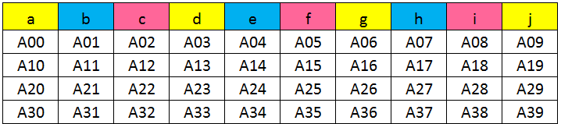
The Array
Array A: Dimensions 4 x 10

Slide 31
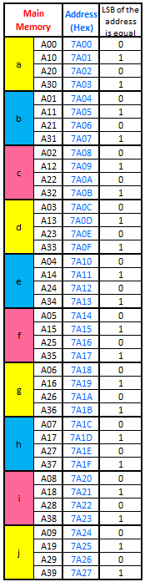
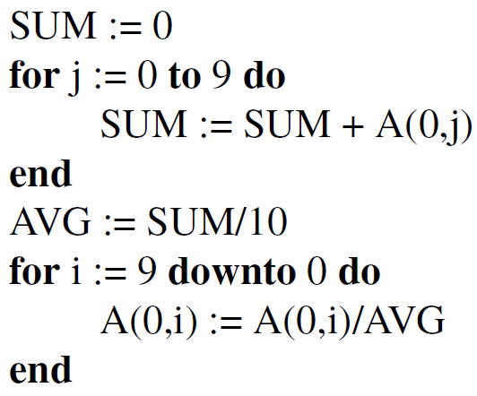
Array A, Stored Colum Wise in MM
Our Code →
For all mapping
Cases

Slide 32
Direct Mapping

Slide 33
Direct Mapping

Slide 34
Direct Mapping

Slide 35
Direct Mapping

Slide 36
Direct Mapping

Slide 37
Direct Mapping

Slide 38
Direct Mapping

Slide 39
Direct Mapping

Slide 40
Direct Mapping

Slide 41
Direct Mapping

Slide 42
Direct Mapping

Slide 43
Direct Mapping

Slide 44
Direct Mapping

Slide 45
Direct Mapping

Slide 46
Direct Mapping

Slide 47
Direct Mapping

Slide 48
Direct Mapping

Slide 49
Direct Mapping

Slide 50
Direct Mapping

Slide 51
Direct Mapping

Slide 52
Direct Mapping

Slide 53
Direct Mapping

Slide 54
Direct Mapping
Hits: Only one (1)
Cache: A lot of useful space was NOT used.

Slide 55
ASSOCIATIVE Mapping

Slide 56
Associative Mapping

Slide 57
Associative Mapping

Slide 58
Associative Mapping

Slide 59
Associative Mapping

Slide 60
Associative Mapping

Slide 61
Associative Mapping

Slide 62
Associative Mapping

Slide 63
Associative Mapping

Slide 64
Associative Mapping

Slide 65
Associative Mapping

Slide 66
Associative Mapping

Slide 67
Associative Mapping

Slide 68
Associative Mapping

Slide 69
Associative Mapping

Slide 70
Associative Mapping

Slide 71
Associative Mapping

Slide 72
Associative Mapping

Slide 73
Associative Mapping

Slide 74
Associative Mapping

Slide 75
Associative Mapping

Slide 76
Associative Mapping

Slide 77
Associative Mapping

Slide 78
Associative Mapping
Hits: Eight (8)
Cache: very well used
savvy use of space
No space was wasted

Slide 79

Set Associative Mapping
Also known as k-way Set-Associative
For this example we will assume 2 Sets, this means this example will be 2-way Set-Associative
Our Dummy cache has 8 blocks, If we evenly divide those 8 blocks in two different sets, then each set will have 4 blocks.
How many bits do I need to ID a word in this dummy MM memory? 1 word per line (2^0 = 1), no bits are needed for 1 word
How many bits do I need to ID a particular set? In this case we have two sets. Then I only need one bit to ID a set, because (2^1 = 2).
In this case, for PC #2, LSB of the address will determine in which SET the corresponding Memory Block maps into
15 bits for the Tag

Slide 80
Set Associative Mapping

Slide 81
Set Associative Mapping

Slide 82
Set Associative Mapping

Slide 83
Set Associative Mapping

Slide 84
Set Associative Mapping

Slide 85
Set Associative Mapping

Slide 86
Set Associative Mapping

Slide 87
Set Associative Mapping

Slide 88
Set Associative Mapping

Slide 89
Set Associative Mapping

Slide 90
Set Associative Mapping

Slide 91
Set Associative Mapping

Slide 92
Set Associative Mapping

Slide 93
Set Associative Mapping

Slide 94
Set Associative Mapping

Slide 95
Set Associative Mapping

Slide 96
Set Associative Mapping

Slide 97
Set Associative Mapping

Slide 98
Set Associative Mapping

Slide 99
Set Associative Mapping

Slide 100
Set Associative Mapping

Slide 101
Set Associative Mapping

Slide 102
Set Associative Mapping
Hits: Four (4)
Cache: better use of space compared to direct mapping, but not as good as Associative mapping

Slide 103
I/O Techniques
When the processor encounters an instruction relating to I/O, it executes that instruction by issuing a command to the appropriate I/O module
Three techniques are possible for I/O operations:
Programmed I/O
Interrupt-Driven I/O
Direct Memory Access (DMA)
Notes:
When the processor is executing a program and encounters an instruction relating to I/O, it executes that instruction by issuing a command to the appropriate I/O module.
Three techniques are possible for I/O operations: programmed I/O, interrupt-driven I/O, and direct memory access (DMA).

Slide 104
Programmed I/O
The I/O module performs the requested action then sets the appropriate bits in the I/O status register
The processor periodically checks the status of the I/O module until it determines the instruction is complete
With programmed I/O the performance level of the entire system is severely degraded
Notes:
In the case of programmed I/O , the I/O module performs the requested action and then sets the appropriate bits in the I/O status register but takes no further action to alert the processor. In particular, it does not interrupt the processor. Thus, after the I/O instruction is invoked, the processor must take some active role in determining when the I/O instruction is completed. For this purpose, the processor periodically checks the status of the I/O module until it finds that the operation is complete.
With programmed I/O, the processor has to wait a long time for the I/O module of concern to be ready for either reception or transmission of more data. The processor, while waiting, must repeatedly interrogate the status of the I/O module. As a result, the performance level of the entire system is severely degraded.

Slide 105
Interrupt-Driven I/O
Processor issues an I/O command to a module and then goes on to do some other useful work
The processor executes the data transfer and then resumes its former processing
The I/O module will then interrupt the processor to request service when it is ready to exchange data with the processor
More efficient than Programmed I/O but still requires active intervention of the processor to transfer data between memory and an I/O module
Notes:
An alternative, known as interrupt-driven I/O , is for the processor to issue an I/O command to a module and then go on to do some other useful work. The I/O module will then interrupt the processor to request service when it is ready to exchange data with the processor. The processor then executes the data transfer, as before, and then resumes its former processing.

Slide 106
Interrupt-Driven I/O Drawbacks
Transfer rate is limited by the speed with which the processor can test and service a device
The processor is tied up in managing an I/O transfer
A number of instructions must be executed for each I/O transfer
Notes:
Interrupt-driven I/O, though more efficient than simple programmed I/O, still requires the active intervention of the processor to transfer data between memory and an I/O module, and any data transfer must traverse a path through the processor. Thus, both of these forms of I/O suffer from two inherent drawbacks:
1. The I/O transfer rate is limited by the speed with which the processor can test and service a device.
2. The processor is tied up in managing an I/O transfer; a number of instructions must be executed for each I/O transfer.

Slide 107
Direct Memory Access (DMA)
Performed by a separate module on the system bus or incorporated into an I/O module
When the processor wishes to read or write data it issues a command to the DMA module containing:
Whether a read or write is requested
The address of the I/O device involved
The starting location in memory to read/write
The number of words to be read/written
Notes:
When large volumes of data are to be moved, a more efficient technique is required: direct memory access (DMA) . The DMA function can be performed by a separate module on the system bus or it can be incorporated into an I/O module. In either case, the technique works as follows. When the processor wishes to read or write a block of data, it issues a command to the DMA module, by sending to the DMA module the following information:
• Whether a read or write is requested
• The address of the I/O device involved
• The starting location in memory to read data from or write data to
• The number of words to be read or written

Slide 108
Direct Memory Access
Transfers the entire block of data directly to and from memory without going through the processor
Processor is involved only at the beginning and end of the transfer
Processor executes more slowly during a transfer when processor access to the bus is required
More efficient than interrupt-driven or programmed I/O
Notes:
The processor then continues with other work. It has delegated this I/O operation to the DMA module, and that module will take care of it. The DMA module transfers the entire block of data, one word at a time, directly to or from memory without going through the processor. When the transfer is complete, the DMA module sends an interrupt signal to the processor. Thus, the processor is involved only at the beginning and end of the transfer.
The DMA module needs to take control of the bus to transfer data to and from memory. Because of this competition for bus usage, there may be times when the processor needs the bus and must wait for the DMA module. Note that this is not an interrupt; the processor does not save a context and do something else. Rather, the processor pauses for one bus cycle (the time it takes to transfer one word across the bus). The overall effect is to cause the processor to execute more slowly during a DMA transfer when processor access to the bus is required. Nevertheless, for a multiple-word I/O transfer, DMA is far more efficient than interrupt-driven or programmed I/O.

Slide 109
Symmetric Multiprocessors (SMP)
A stand-alone computer system with the following characteristics:
Two or more similar processors of comparable capability
Processors share the same main memory and are interconnected by a bus or other internal connection scheme
Processors share access to I/O devices
All processors can perform the same functions
The system is controlled by an integrated operating system that provides interaction between processors and their programs at the job, task, file, and data element levels
Notes:
An SMP can be defined as a stand-alone computer system with the following characteristics:
1. There are two or more similar processors of comparable capability.
2. These processors share the same main memory and I/O facilities and are interconnected by a bus or other internal connection scheme, such that memory access time is approximately the same for each processor.
3. All processors share access to I/O devices, either through the same channels or through different channels that provide paths to the same device.
4. All processors can perform the same functions (hence the term symmetric ).
5. The system is controlled by an integrated operating system that provides interaction between processors and their programs at the job, task, file, and
data element levels.
Points 1 to 4 should be self-explanatory. Point 5 illustrates one of the contrasts with a loosely coupled multiprocessing system, such as a cluster. In the latter, the physical unit of interaction is usually a message or complete file. In an SMP, individual data elements can constitute the level of interaction, and there can be a high degree of cooperation between processes.

Slide 110
SMP Advantages
Performance
A system with multiple processors will yield greater performance if work can be done in parallel
Availability
The failure of a single processor does not halt the machine
Incremental Growth
An additional processor can be added to enhance performance
Scaling
Vendors can offer a range of products with different price and performance characteristics
Notes:
An SMP organization has a number of potential advantages over a uniprocessor organization, including the following:
• Performance: If the work to be done by a computer can be organized so that some portions of the work can be done in parallel, then a system with multiple processors will yield greater performance than one with a single processor of the same type.
Availability: In a symmetric multiprocessor, because all processors can perform the same functions, the failure of a single processor does not halt the machine. Instead, the system can continue to function at reduced performance.
• Incremental growth: A user can enhance the performance of a system by adding an additional processor.
• Scaling: Vendors can offer a range of products with different price and performance characteristics based on the number of processors configured in the system.
It is important to note that these are potential, rather than guaranteed, benefits. The operating system must provide tools and functions to exploit the parallelism in an SMP system. An attractive feature of an SMP is that the existence of multiple processors is transparent to the user. The operating system takes care of scheduling of tasks on individual processors and of synchronization among processors.

Slide 111
SMP (Symmetric Multiprocessors)
Notes:
Figure 1.19 illustrates the general organization of an SMP.
There are multiple processors, each of which contains its own control unit, arithmetic logic unit, and registers. Each processor has access to a shared main memory and the I/O devices through some form of interconnection mechanism; a shared bus is a common facility. The processors can communicate with each other through memory (messages and status information left in shared address spaces). It may also be possible for processors to exchange signals directly. The memory is often organized so that multiple simultaneous accesses to separate blocks of memory are possible.
In modern computers, processors generally have at least one level of cache memory that is private to the processor. This use of cache introduces some new design considerations. Because each local cache contains an image of a portion of main memory, if a word is altered in one cache, it could conceivably invalidate a word in another cache. To prevent this, the other processors must be alerted that an update has taken place. This problem is known as the cache coherence problem and is typically addressed in hardware rather than by the OS.

Slide 112
SMP (Symmetric Multiprocessors)
There are multiple processors
Each processor has two dedicated levels of cache (L1 and L2)
Each processor has access to shared MM and I/O devices through some form of interconnection mechanism
The processors can communicate via
Messages (left in shared spaces)
Signals
Memory is often organized so multiple simultaneous accesses to separate blocks of memory are possible.

Slide 113
Multicore Computer
Also known as a chip multiprocessor
Combines two or more processors (cores) on a single piece of silicon (die)
Each core consists of all of the components of an independent processor (ALU, registers, Pipeline HW, control unit, L1 instruction & data caches)
In addition, multicore chips also include L2 cache and in some cases L3 cache
Notes:
A multicore computer, also known as a chip multiprocessor , combines two or more processors (called cores) on a single piece of silicon (called a die). Typically, each core consists of all of the components of an independent processor, such as registers, ALU, pipeline hardware, and control unit, plus L1 instruction and data caches. In addition to the multiple cores, contemporary multicore chips also include L2 cache and, in some cases, L3 cache.
The motivation for the development of multicore computers can be summed up as follows. For decades, microprocessor systems have experienced a steady, usually exponential, increase in performance. This is partly due to hardware trends, such as an increase in clock frequency and the ability to put cache memory closer to the processor because of the increasing miniaturization of microcomputer components. Performance has also been improved by the increased complexity of processor design to exploit parallelism in instruction execution and memory access. In brief, designers have come up against practical limits in the ability to achieve greater performance by means of more complex processors. Designers have found that the best way to improve performance to take advantage of advances in hardware is to put multiple processors and a substantial amount of cache memory on a single chip. A detailed discussion of the rationale for this trend is beyond our scope, but is summarized in Appendix C .

Slide 114
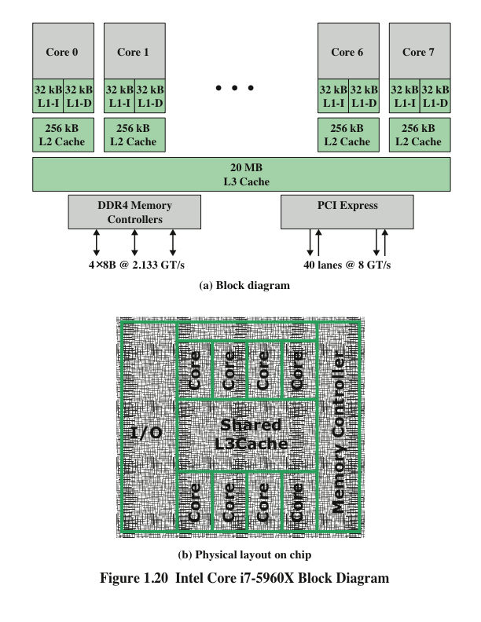
Notes:
An example of a multicore system is the Intel Core i7-5960X, which includes
six x86 processors, each with a dedicated L2 cache, and with a shared L3 cache
(Figure 1.20a). One mechanism Intel uses to make its caches more effective is
prefetching, in which the hardware examines memory access patterns and attempts to
fill the caches speculatively with data that’s likely to be requested soon. Figure 1.20b
shows the physical layout of the 5960X in its chip.
The Core i7-5960X chip supports two forms of external communications to
other chips. The DDR4 memory controller brings the memory controller for the
DDR (double data rate) main memory onto the chip. The interface supports four
channels that are 8 bytes wide for a total bus width of 256 bits, for an aggregate data
rate of up to 64 GB/s. With the memory controller on the chip, the Front Side Bus is
eliminated. The PCI Express is a peripheral bus. It enables high-speed communications
among connected processor chips. The PCI Express link operates at 8 GT/s
(transfers per second). At 40 bits per transfer, that adds up to 40 GB/s.

Slide 115
Summary
Basic Elements
Evolution of the microprocessor
Instruction execution
Interrupts
Interrupts and the instruction cycle
Interrupt processing
Multiple interrupts
The memory hierarchy
Cache memory
Motivation
Cache principles
Cache design
Direct memory access
Multiprocessor and multicore organization
Symmetric multiprocessors
Multicore computers
Notes:
Summary of Chapter 1.

